Slide 1
Employee Attrition Project
From Data Insights to a Deployed Solution

Slide 2

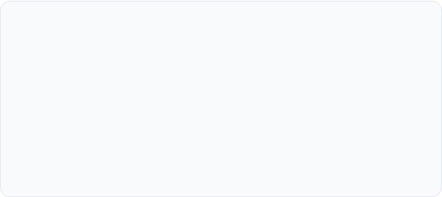
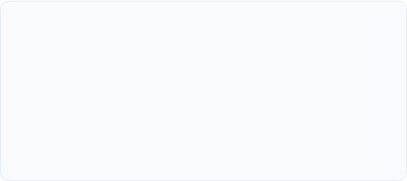
The Challenge & The Data
Business Problem
Our Data (The CSV File)
We needed to move from being reactive to proactive about employee retention. The goal was to identify at-risk employees *before* they leave.
We used the `Employee-Attrition.csv` file, which contained employee profiles, job details (like role, income) and sentiment data (like job satisfaction).

Slide 3
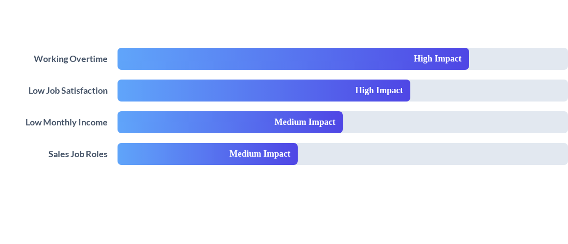
Key Insights (EDA)
Our analysis (EDA) confirmed that factors like overtime and low satisfaction are the strongest drivers of attrition.

Slide 4
The Predictive Model (ML)
Our Model's Job
We built a Random Forest model, which is highly accurate.
It analyzes an employee's data to predict their risk of leaving.
The model is optimized for "Recall" – meaning it's excellent at *finding* potential leavers.
This model is the "engine" for our new tool.

Slide 5
The Solution (Streamlit)
HR Attrition Dashboard
The ML model is deployed in a simple, secure Streamlit web application.
This dashboard provides real-time risk scoring. HR can now access data-driven insights to start supportive conversations with at-risk employees immediately.

Slide 6
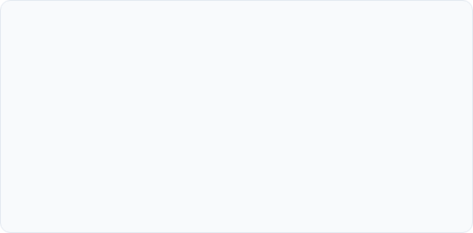
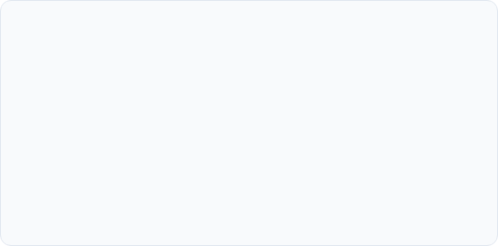
Business Impact & Next Steps
Business Impact
Recommended Next Steps
This tool transforms our retention strategy from reactive to proactive. It empowers HR with data, reduces talent loss, and provides a clear ROI by saving on recruitment and training costs.
1. Pilot the Streamlit tool with HR Business Partners for Q1.
2. Integrate feedback to refine the dashboard.
3. Retrain the model quarterly with new data to maintain accuracy.

Slide 7
Thank You

